Slide 1
Classification and Prediction
Vijayalakshmi Anand

Slide 2
Classification and Prediction
Classification
Rule Based classifier
Prediction
Linear Regression
Non Linear Regression
Methods to measure Classification algorithm

Slide 3
Rule-Based Classifier
Classify records by using a collection of “if…then…” rules
Rule: (Condition) → y where
Condition is a conjunctions of attributes
y is the class label
LHS: rule antecedent or condition
RHS: rule consequent
Examples of classification rules:
(Blood Type=Warm) ∧ (Lay Eggs=Yes) → Birds
(Taxable Income < 50K) ∧ (Refund=Yes) → Evade=No

Slide 4
Rule-based Classifier (Example)
R1: (Give Birth = no) ∧ (Can Fly = yes) → Birds
R2: (Give Birth = no) ∧ (Live in Water = yes) → Fishes
R3: (Give Birth = yes) ∧ (Blood Type = warm) → Mammals
R4: (Give Birth = no) ∧ (Can Fly = no) → Reptiles
R5: (Live in Water = sometimes) → Amphibians

Slide 5
Application of Rule-Based Classifier
A rule r covers an instance x if the attributes of the instance satisfy the condition of the rule
R1: (Give Birth = no) ∧ (Can Fly = yes) → Birds
R2: (Give Birth = no) ∧ (Live in Water = yes) → Fishes
R3: (Give Birth = yes) ∧ (Blood Type = warm) → Mammals
R4: (Give Birth = no) ∧ (Can Fly = no) → Reptiles
R5: (Live in Water = sometimes) → Amphibians
The rule R1 covers a hawk => Bird
The rule R3 covers the grizzly bear => Mammal

Slide 6
Rule Coverage and Accuracy
Coverage of a rule:
Fraction of records that satisfy the antecedent of a rule
Accuracy of a rule:
Fraction of records that satisfy both the antecedent and consequent of a rule

Slide 7
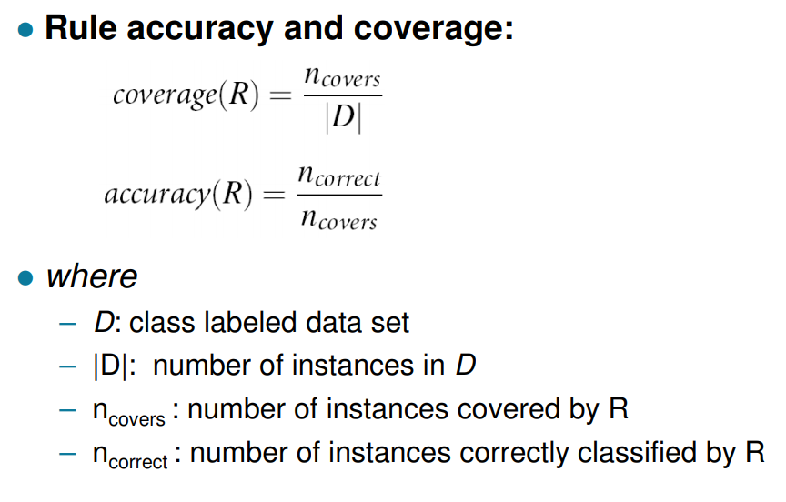


Contd..
or
or

Slide 8
Example 1
(Status=Single) → No
= 4/10=0.4
Coverage = 40%
=2/4 =0.5
Accuracy = 50%

Slide 9
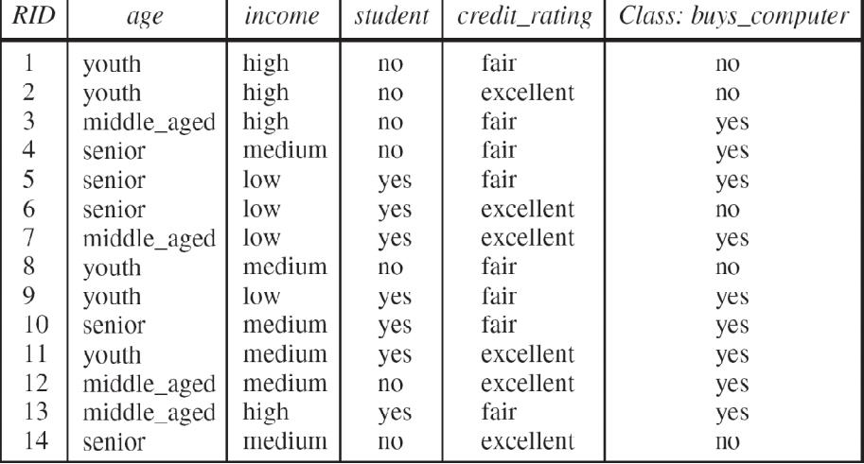
Example2

Slide 10
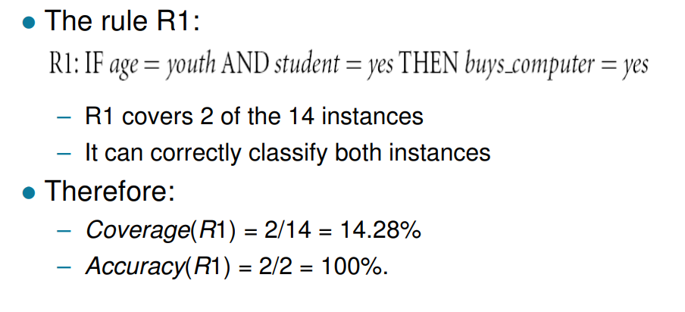
Contd..
What is the coverage and accuracy?
R1:(age=youth)^(student=yes) (buys computer=Yes)
Coverage=?
Accuracy=?

Slide 11
Characteristics of Rule-Based Classifier
Mutually exclusive rules
Classifier contains mutually exclusive rules if the rules are independent of each other
Every record is covered by at most one rule
Exhaustive rules
Classifier has exhaustive coverage if it accounts for every possible combination of attribute values
Each record is covered by at least one rule

Slide 12
How does Rule-based Classifier Work?
R1: (Give Birth = no) ∧ (Can Fly = yes) → Birds
R2: (Give Birth = no) ∧ (Live in Water = yes) → Fishes
R3: (Give Birth = yes) ∧ (Blood Type = warm) → Mammals
R4: (Give Birth = no) ∧ (Can Fly = no) → Reptiles
R5: (Live in Water = sometimes) → Amphibians
A lemur triggers rule R3, so it is classified as a mammal
A turtle triggers both R4 and R5
A dogfish shark triggers none of the rules

Slide 13
Solution
Rules are no longer mutually exclusive
A record may trigger more than one rule
Solution?
Ordered rule set
Unordered rule set – use voting schemes
Rules are no longer exhaustive
A record may not trigger any rules
Solution?
Use a default class

Slide 14
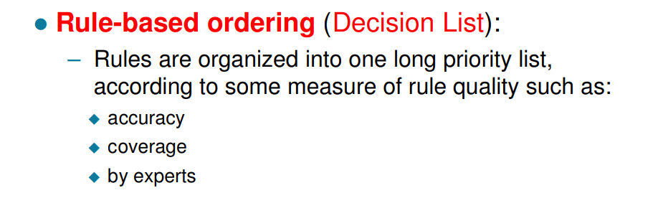
Rule Ordering Schemes

Slide 15
Ordered Rule Set
When a test record is presented to the classifier
It is assigned to the class label of the highest ranked rule it has triggered
R1: (Give Birth = no) ∧ (Can Fly = yes) → Birds
R2: (Give Birth = no) ∧ (Live in Water = yes) → Fishes
R3: (Give Birth = yes) ∧ (Blood Type = warm) → Mammals
R4: (Give Birth = no) ∧ (Can Fly = no) → Reptiles
R5: (Live in Water = sometimes) → Amphibians

Slide 16
Class-based ordering
Class-based ordering
Rules that belong to the same class appear together
Difference between Rule based and class based ordering

Slide 17
Unordered Rule set
-Majority voting is considered
R1
x1 R2
R4
R5

Slide 18
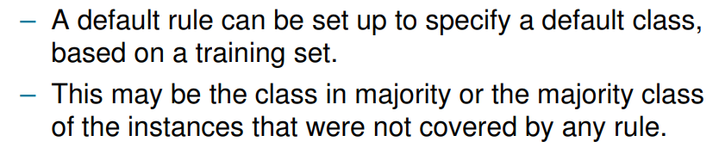
Solution for Not Exhaustive Rule -Default class

Slide 19
Building Classification Rules
Direct Method:
Extract rules directly from data
e.g.: RIPPER, CN2, Holte’s 1R
Indirect Method:
Extract rules from other classification models (e.g. decision trees, neural networks, etc).
e.g: C4.5rules

Slide 20
Direct Method: Sequential Covering
Start from an empty rule
Grow a rule using the Learn-One-Rule function
Remove training records covered by the rule
Repeat Step (2) and (3) until stopping criterion is met

Slide 21
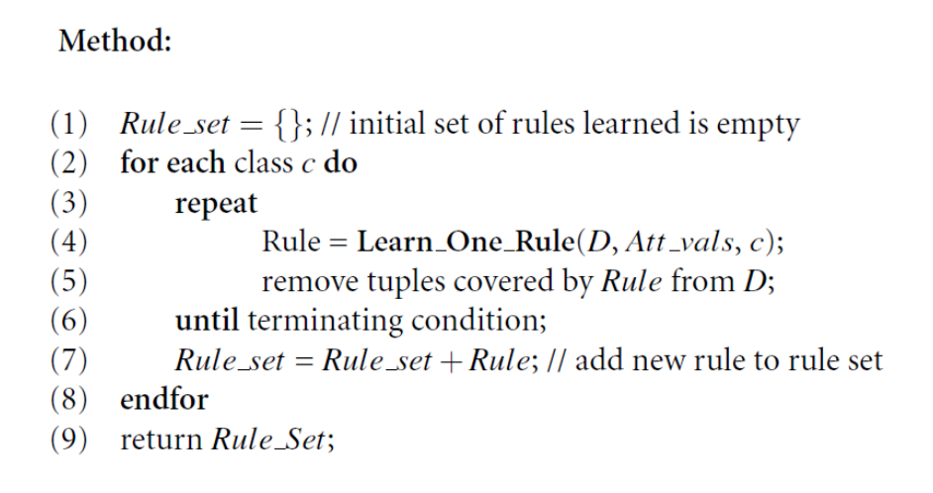
Algorithm

Slide 22
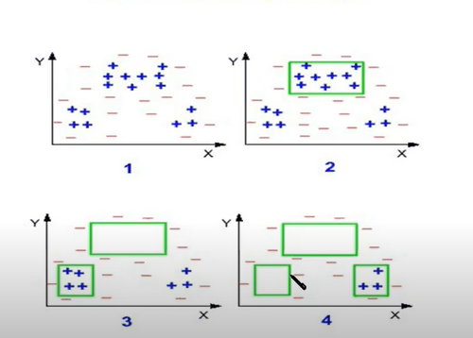
Example1

Slide 23
Example2: Generating A Rule Example
Suppose our training set, D, consists of loan application data.
– Attributes regarding each applicant include their:
age
income
education level
residence
credit rating
the term of the loan.
– The classifying attribute is loan_decision, which indicates whether a loan is accepted (considered safe) or rejected (considered risky).

Slide 24

Contd.
To learn a rule for the class “accept,”
we start off with the most general rule possible, that is, the condition of the rule precondition is empty.
The rule is:
We then consider each possible attribute test that may be added to the rule.

Slide 25
Contd..
Each time it is faced with adding a new attribute test to the current rule, it picks the one that most improves the rule quality, based on the training samples.
The process repeats, where at each step, we continue to greedily grow rules until the resulting rule meets an acceptable quality level.

Slide 26
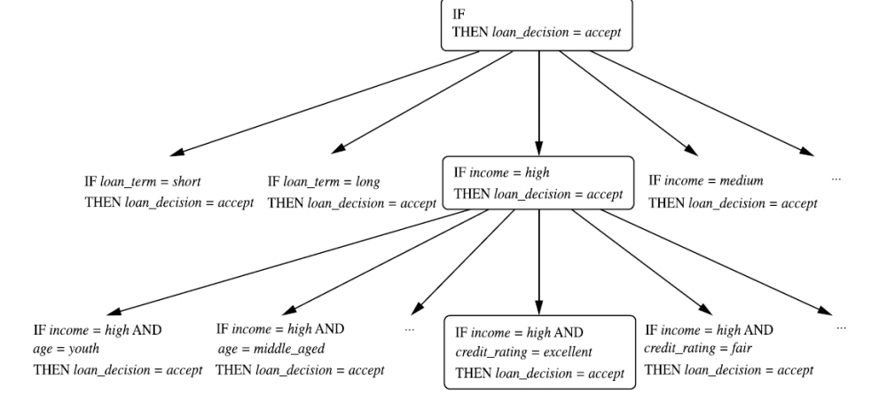
Contd..

Slide 27
Indirect method-From Decision Trees To Rules
Rules are mutually exclusive and exhaustive
Rule set contains as much information as the tree

Slide 28
Rules Can Be Simplified
Initial Rule: (Refund=No) ∧ (Status=Married) → No
Simplified Rule: (Status=Married) → No

Slide 29

How to Evaluate Learnt Rule
Rule-Quality measures: consider both coverage and accuracy
Foil-gain (First order inductive learner): assesses info_gain by extending condition
R0: {} →→ class (initial rule)
R1: {A} →→ class (rule after adding conjunct)
t number of positive instances covered by both R0 and R1
p0: number of positive instances covered by R0
n0: number of negative instances covered by R0
p1: number of positive instances covered by R1
n1: number of negative instances covered by R1

Slide 30
Pruning rule
Rule pruning based on an independent set of test tuples
Pos/neg are # of positive/negative tuples covered by R.
If FOIL_Prune is higher for the pruned version of R, prune R

Slide 31
Ensemble methods

Slide 32
Ensemble Methods
Classification technique
Combines many base models and produce a optimal predictive model

Slide 33
General Idea

Slide 34
Why does it work?

Slide 35
Prediction

Slide 36
Prediction vs. Classification
How is (Numerical) prediction similar to classification?
construct a model
use model to predict continuous or ordered value for a given input
Difference between Prediction and classification
Classification refers to predict categorical class label
Prediction models continuous-valued functions
Advantages
Profit, sales, mortgage rates, house values, square footage, temperature, or distance could all be predicted using regression techniques.
For example, a regression model could be used to predict the value of a house based on location, number of rooms, lot size, and other factors.

Slide 37
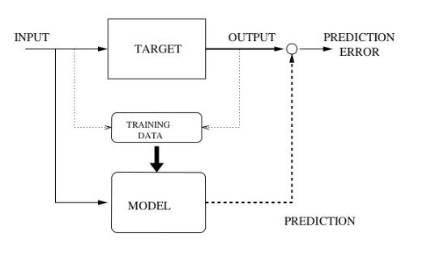
Regression for Prediction

Slide 38
Prediction Techniques
Regression analysis
Linear regression
multiple regression
Non-linear regression
Other regression method:
regression trees

Slide 39
Regression analysis
Regression analysis seeks to determine the values of parameters for a function that cause the function to best fit a set of data observations that you provide.
The following equation expresses these relationships in symbols. It shows that regression is the process of estimating the value of a continuous target (y) as a function (F) of one or more predictors (x1 , x2 , ..., xn), a set of parameters (w1 , w2 , ..., wn), and a measure of error (e).
y = w+mx+ e
The predictors can be understood as independent variables and the target as a dependent variable. The error, also called the residual, is the difference between the expected and predicted value of the dependent variable. The regression parameters are also known as regression coefficients.
The process of training a regression model involves finding the parameter values that minimize a measure of the error, for example, the sum of squared errors.

Slide 40
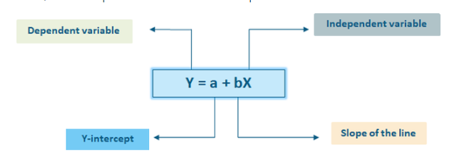
Linear Regression
Linear regression: involves a response variable y and a single predictor variable x
In linear regression we want to find a best fit straight line to predict the values

Slide 41
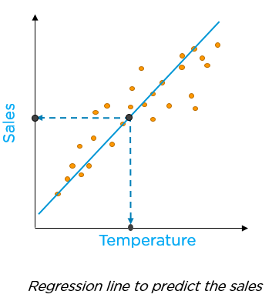
How to decide the best fit?

Slide 42
Linear Regression
Method of least squares: estimates the best-fitting straight line
Where is arithmetic mean of all y’s and is arithmetic mean of all x’s
X is x axis value of each data points and y is y axis value of each data points
n is the number of data points

Slide 43
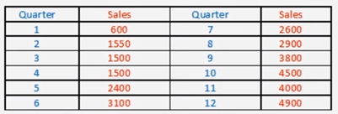
Linear Regression Example
Maxus sales cooperation is in the business of selling laptops. They realized the advantages of forecasting very early in their business and to do the same they need to keep track of their current and past sales numbers
Below are the details which they have collected :
By using Least-squares method find forecast for the next four quarters, also find out the Standard error of the estimate.
Dependent and independent variable?

Slide 44
Linear Regression Example
arithmetic mean of x’s = 78/12 = 6.5
Arithmetic mean of ys =33350/12 = 2779.17
X | y | XY | x2
1 | 600 | 600 | 1
2 | 1550 | 3100 | 4
3 | 1500 | 4500 | 9
4 | 1500 | 6000 | 16
5 | 2400 | 12000 | 25
6 | 3100 | 18600 | 36
7 | 2600 | 18200 | 49
8 | 2900 | 23200 | 64
9 | 3800 | 34200 | 81
10 | 4500 | 45000 | 100
11 | 4000 | 44000 | 121
12 | 4900 | 58800 | 144
78 | 33350 | 268200 | 650
= 359.7
= 441.12

Slide 45
Linear Regression Example
Y = a + bX so Y = 441.12 + 359.7*X
So, forecast for the next four quarters will be
Y13 = 441.12 + 359.3 * 13 = 5112.02
Y14 = 441.12 + 359.3 * 14 = 5471.32
Y15 = 441.12 + 359.3 * 15 = 5830.62
Y16 = 441.12 + 359.3 *16 = 6189.92
Now, Standard error of the estimate can be find out by using

Slide 46

Linear Regression Example
So,
Syx = 363.9
Another way to calculated Syx is :
x | y | y' | (y-y')2
1 | 600 | 801.37 | 40549.87
2 | 1550 | 1160.97 | 151344.34
3 | 1500 | 1520.57 | 423.12
4 | 1500 | 1880.17 | 144529.22
5 | 2400 | 2239.12 | 25882.37
6 | 3100 | 2599.37 | 250630.39
7 | 2600 | 2958.97 | 128859.46
8 | 2900 | 3318.57 | 175200.84
9 | 3800 | 3678.17 | 14842.54
10 | 4500 | 4037.77 | 213656.57
11 | 4000 | 4397.37 | 157902.91
12 | 4900 | 4756.97 | 20457.58
78 | 33350 |  | 1324279.21

Slide 47
Multiple linear regression
Multiple linear regression: involves more than one predictor variable
Training data is of the form (X₁, y₁), (X₂, y₂),…, (X_{|D|}, y_{|D|})
Ex. For 2-D data, we may have:
y = w₀ + w₁ x₁+ w₂ x₂

Slide 48
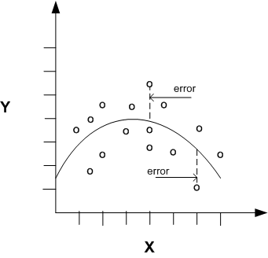
Nonlinear Regression
Nonlinear regression models define y as a function of x using an equation that is more complicated than the linear regression equation

Slide 49
Model Evaluation and Selection

Slide 50
Model Evaluation and Selection
Evaluation metrics: How can we measure accuracy? Other metrics to consider?
Use validation test set of class-labeled tuples instead of training set when assessing accuracy
Methods for estimating a classifier’s accuracy:
Holdout method, random subsampling
Cross-validation
Bootstrap
50

Slide 51
Classifier Evaluation Metrics: Confusion Matrix
-Confusion matrix C is such that Ci,j is equal to the number of observations known to be in group i and predicted to be in group j.
Thus in binary classification, the count of true negatives is C0,0, false negatives is C1,0, true positives is C1,1 and false positives is C0,1
Actual
predicted
 | C₁ | C₀
C₁ | True Positives (TP) | False Positives (FP)
C₀ | False Negatives (FN) | True Negatives (TN)
51

Slide 52
Classifier Evaluation Metrics: Confusion Matrix
Example of Confusion Matrix:
Predicted class -> | buy_computer = yes | buy_computer = no | Total
Actual class ⇓
buy_computer = yes | 6954 | 46 | 7000
buy_computer = no | 412 | 2588 | 3000
Total | 7366 | 2634 | 10000
52

Slide 53
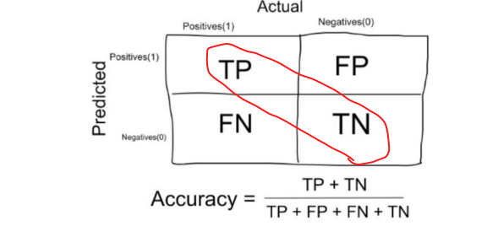
Evaluation measures
Accuracy:

Slide 54
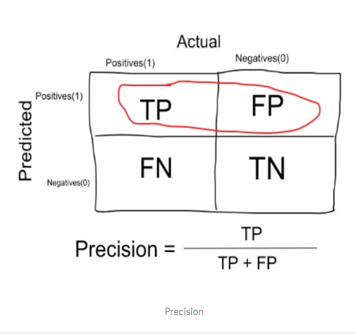
Contd..
Precision

Slide 55
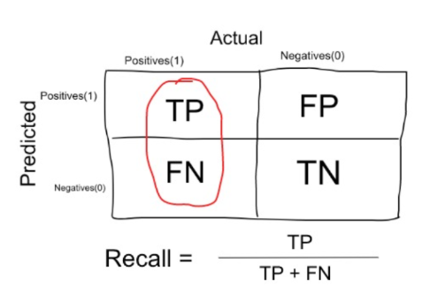
Contd..
Recall or sensitivity

Slide 56
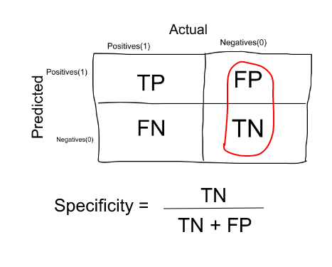
Contd..
Specificity:

Slide 57
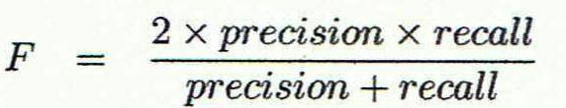
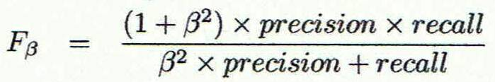
Contd..
F-measures
F measure (F₁ or F-score): harmonic mean of precision and recall,
weighted measure of precision and recall
assigns ß times as much weight to recall as to precision
57

Slide 58
Classifier Evaluation metrics: Example
Precision = 90/300 = 30% Recall = 90/230 = 39.13%
accuracy =90+9560/10000=96.5
 | cancer = yes | cancer = no | Total
cancer = yes | 90 | 210 | 300
cancer = no | 140 | 9560 | 9700
Total | 230 | 9770 | 10000
58

Slide 59
Evaluating Classifier Accuracy: Holdout & Cross-Validation Methods
Holdout method
Given data is randomly partitioned into two independent sets
Training set (e.g., 2/3) for model construction
Test set (e.g., 1/3) for accuracy estimation
Cross-validation (k-fold, where k = 10 is most popular)
Randomly partition the data into k mutually exclusive subsets, each approximately equal size
At i-th iteration, use D_{i} as test set and others as training set
Leave-one-out: k folds where k = # of tuples, for small sized data
59

Slide 60
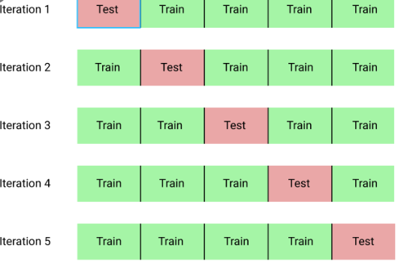
Example

Slide 61
Thank You

